Slide 1
Norwegian University
Of Life Sciences
Semantic Enhancements in Image Captioning:
Leveraging Neural Networks to Improve BLIP and GPT-2
07.06.2024
Master’s Thesis 2024
30 ECTS
Faculty of Science and Technology
Sushant Kumar Srivastava
Master of Science in Data Science

Slide 2





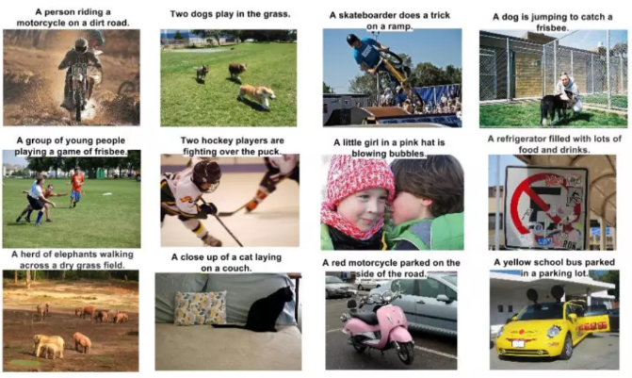
Introduction to Image Captioning:
Focus Areas:
Computer Vision: Enables machines to see and interpret visual data.
Natural Language Processing (NLP): Allows machines to understand and generate human language.
Application: Image Captioning
Accessibility for Visually Impaired Persons, Social Media Platforms, Content Management and Digital Libraries, Healthcare
Advancement: Progresses from simple image tags to generating detailed, meaningful descriptions.
Evolution of Technology:
Initial Methods: Started with basic keyword matching.
Current Tech: Employs advanced deep learning and neural networks.
Ongoing Challenges:
Contextual Relevance: Ensuring descriptions are accurate within varied contexts.
Linguistic Precision: Achieving high-level language accuracy and appropriateness.

Slide 3
Challenges in Image Captioning:
Contextual Understanding: Models often struggle to fully capture the setting and mood of scenes. Example: A system might describe a picnic simply by the visible items, missing the context like "a family enjoying a sunny day.“
Semantic Richness: Achieving detailed and nuanced captions remains difficult. Example: A basic description of "a man kicks a ball" versus a more detailed "a player scores a winning goal during a championship match.“
Visual Ambiguities: Images with complex or deceptive elements challenge the accuracy of captions. Example: Misidentifying a person wearing a mask as two people.
Linguistic Precision: Generating grammatically correct and stylistically appropriate text is critical. Example: Correcting awkward phrases like "cat sit on a mat" to "a cat sits on a mat.“
Real-Time Processing: Delivering accurate captions for live content demands high-speed processing. Example: Instant captioning in live sports can struggle with rapid scene changes.
Problem with state-of-the-art models:
Inefficiencies in Retraining: High resource demands for frequent updates.
Example: Continuous retraining for new data recognition.
Lack of Sustainability: Environmental impact of extensive data training.
Example: Energy-intensive training on large-scale image datasets.

Slide 4
Our approach:
We introduce a novel method that integrates two advanced models like BLIP and GPT-2 with a 'Weighted Summarization' technique. This approach uses artificial neural networks to optimize the combination of outputs from different models, enhancing the semantic accuracy and reducing the dependency on retraining.
Research question:
Can we develop a method that does not rely on retraining, operates at a low cost, and generates captions that are more semantically accurate than those produced by existing models like BLIP and GPT-2?
Q1: Are advanced models like BLIP and GPT-2 predisposed to generating more accurate and semantically rich captions for certain categories of images?
Q2: How do these models enhance the semantic accuracy and contextual relevance of captions across varied datasets like COCO and FLICKR?
Q3: Can integrating outputs from multiple captioning models through advanced summarization techniques and neural networks improve the semantic depth of generated captions?
Q4: To what extent do these strategies and ANN findings surpass state-of-the-art models in terms of semantic accuracy and evaluation metrics for generated captions?

Slide 5
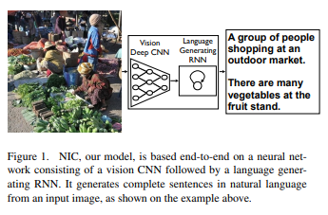
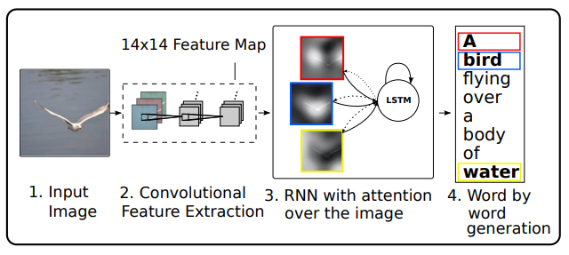
Literature Review - Key Studies and Models in Image Captioning
Early Methods of Basic Tags and Labels:
Early image captioning methods relied on simple keyword matching and object recognition to label images. This approach was limited to identifying and tagging objects without understanding the context or generating descriptive sentences.
Vinyals et al. (2015): Neural Networks for Caption Generation
Introduced the concept of using deep neural networks for generating image captions.
Developed an end-to-end neural network model that combines Convolutional Neural Networks (CNNs) for image feature extraction and Recurrent Neural Networks (RNNs) for sequence generation.
Xu et al. (2015): Attention Mechanisms
Introduced attention mechanisms to improve image captioning models.
Developed a model that uses an attention mechanism to dynamically focus on different parts of the image as each word of the caption is generated.
The attention mechanism allows the model to learn which parts of the image are most relevant for generating the next word in the caption.
Fig a. Vinyals et al. (2015)
Fig b. Stephen et al. (2019)

Slide 6
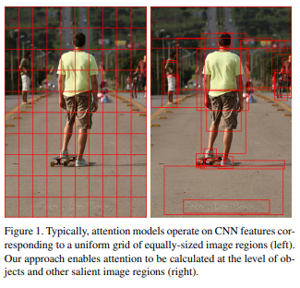
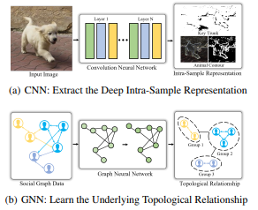
Literature Review - Key Studies and Models in Image Captioning
Anderson et al. (2018): Bottom-Up and Top-Down Attention
Developed a combined bottom-up and top-down attention mechanism.
Bottom-up attention allows the model to attend to specific objects detected in the image, while top-down attention focuses on the context of the entire scene.
Cornia et al. (2020): CNNs with Graph Neural Networks
Integrated CNNs with Graph Neural Networks (GNNs) for improved image captioning.
The model uses CNNs to extract visual features and GNNs to capture relationships between objects in the image.
Fig c. Anderson et al. (2018)
Fig c. Ziheng Jiao et al. (2024)

Slide 7
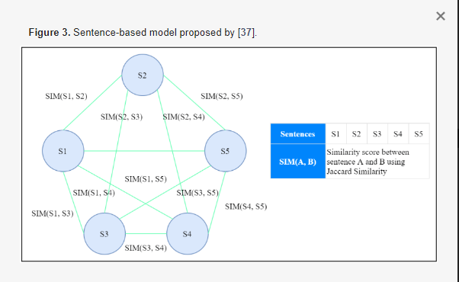
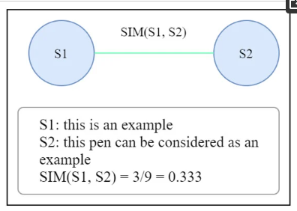
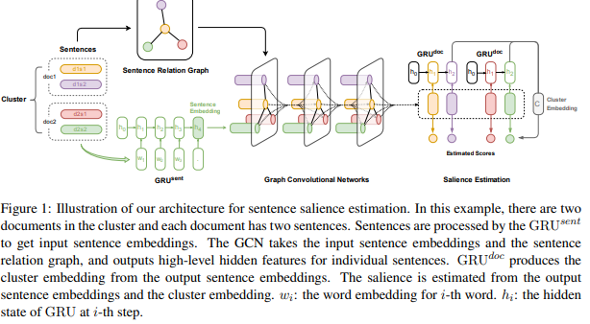
Literature Review - Summarization Techniques
Extractive Summarization
Extractive summarization involves selecting key sentences or segments from the original text and combining them to form a summary.
Erkan and Radev (2004): Graph-Based Centrality Scoring
Introduced a graph-based approach to identify and score the most important sentences in a text.
Used sentence centrality, where sentences are nodes in a graph, and edges represent similarity between sentences.
Centrality scores determine the importance of each sentence.
Yasunaga et al. (2017): Advanced Graph Models
Enhanced extractive summarization by incorporating deeper sentence interconnections.
Developed models that evaluate sentence relationships more accurately within the text graph.
Fig a. Verma et al. (2023)
Fig b. Yasunaga et al. (2017)

Slide 8
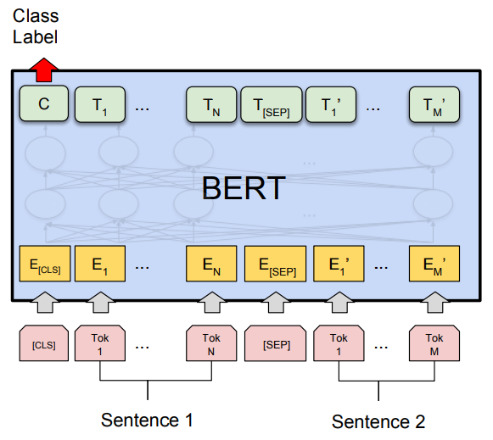
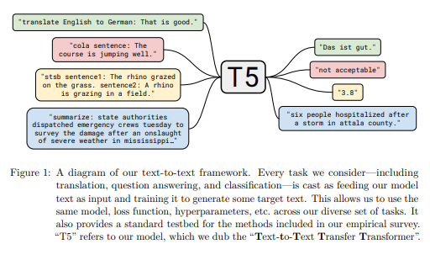
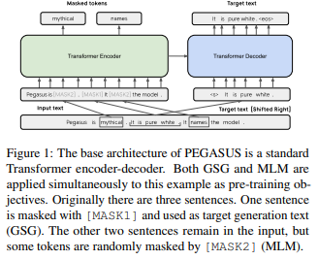
Literature Review - Summarization Techniques
Abstractive Summarization
Abstractive summarization generates concise paraphrases of the original text, often producing new sentences not present in the original content.
Devlin et al. (2019): BERT (Bidirectional Encoder Representations from Transformers)
Introduced BERT for various NLP tasks, including summarization.
BERT uses bidirectional training of transformers, considering the context from both sides of a word.
Fine-tuned for summarization tasks to generate coherent summaries.
Brown et al. (2020): GPT-3 (Generative Pre-trained Transformer 3)
Developed a large-scale transformer model with state-of-the-art performance in text generation.
GPT-3 is pre-trained on a diverse dataset, enabling it to generate high-quality text based on given prompts.
Raffel et al. (2020): T5 (Text-To-Text Transfer Transformer)
Unified approach for various text-based tasks by converting them into a text-to-text format.
Pre-trained on a large corpus and fine-tuned for summarization.
Zhang et al. (2020): PEGASUS
Optimized pre-training objectives for abstractive summarization.
Focused on gap sentences to predict and generate relevant content.
Demonstrated superior performance in generating concise and accurate summaries.
Fig c. Devlin et al. (2019)
Fig d. Brown et al. (2020)
Fig e. Zhang et al. (2020)

Slide 9
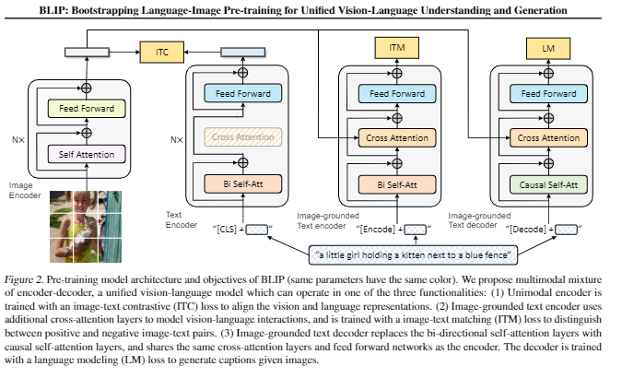
State-of-the-art Models: BLIP
BLIP (Bootstrapping Language-Image Pre-training) integrates vision and language for unified understanding and generation, enhancing AI's multimedia interactions.
Multimodal Encoder-Decoder Framework: Utilizes a multimodal encoder-decoder framework with separate encoders for images and text, increasing the model's flexibility in handling tasks.
Cross-Attention Mechanisms: Employs sophisticated cross-attention mechanisms for deep intermodal communication, crucial for precise image-text alignment.
Training Objectives: Trained through diverse objectives such as Image-Text Contrastive (ITC) Loss for alignment, Image-Text Matching (ITM) for accuracy, and Language Modeling (LM) for contextual generation.
Applications of BLIP: Applications cover automated content creation, assistive technologies, and interactive systems, revolutionizing how AI interacts in multimodal contexts.
Impact of BLIP:Holds a potentially transformative impact on the way machines understand and generate human-like responses across various scenarios.
Fig b. J. Li et al. (2022)

Slide 10
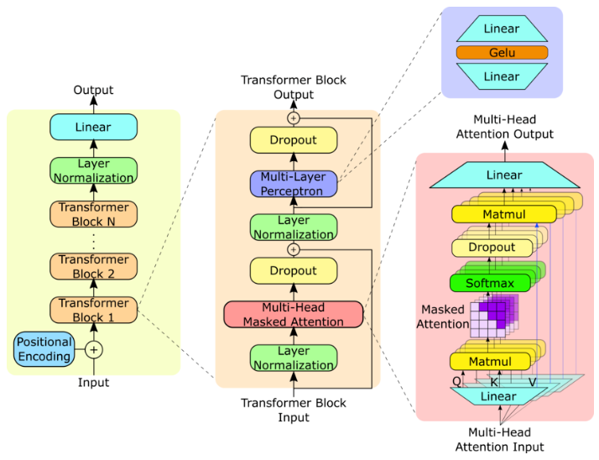
State-of-the-art Models: GPT-2
GPT-2 features a series of transformer blocks that process text input for natural language understanding and generation.
Transformer Blocks: Each block contains a multi-head masked attention mechanism, a multi-layer perceptron (MLP), and several normalization and dropout layers to enhance performance and prevent overfitting.
Input Processing: Starts with positional encoding added to the input to retain the sequence information, crucial for text processing.
Multi-Head Masked Attention: Allows the model to focus on different parts of the input sequence simultaneously, improving context understanding.
Layer Normalization and Dropout: Used within each transformer block to stabilize learning and reduce the chance of overfitting.
Output Generation: The output from the final transformer block is passed through a linear layer to produce the final predictions or text generation.
Fig b. Steve D Yang et al. (2023)

Slide 11
Gaps and Contributions
Identified Gaps:
Frequent and Costly Retraining:
Challenge:
Existing models require frequent retraining to maintain performance, which is computationally expensive and time-consuming.
Impact:
Limits the scalability and practicality of these models for real-world applications.
Difficulty in Generating Semantically Rich Captions:
Challenge:
Models often struggle to generate captions that are both semantically accurate and contextually relevant.
Impact:
Reduces the effectiveness of image captioning systems in accurately describing complex scenes.
Our Contributions:
Weighted Summarization:
Innovation:
Introduced a new approach that combines outputs from multiple models to improve caption quality.
Methodology:
Used artificial neural networks to assign weights to different model outputs based on their strengths.
Integrated these weighted outputs to generate more accurate and contextually relevant captions.
Significance:
Reduced the need for frequent retraining by leveraging pre-trained models more effectively.
Enhancements to BLIP and GPT-2:
Innovation:
Improved the performance of existing models by integrating them with the Weighted Summarization approach.
Methodology:
Applied advanced neural network techniques to enhance the caption generation capabilities of BLIP and GPT-2.
Significance:
Achieved higher evaluation metrics (BLEU, METEOR, ROUGE) compared to existing state-of-the-art models.

Slide 12
Methodology - Research Design and Approach:
The primary goal is to develop a method that improves caption accuracy and relevance without the need for frequent retraining.
Data Sources:
COCO Dataset:
Contains diverse and complex scenes, providing a robust dataset for testing various captioning models (used 1100 image-caption pairs in this research).
FLICKR Dataset:
Focuses on varied real-world images to assess model performance across different contexts (used 1100 image-caption pairs in this research).
BLIP
(label=1)
BLIP Caption (more weight) + GPT2 caption (less weight)
Dataset
Data Preparation
Data Preprocessing and Feature Extraction
ANN
Weighted Summarization
Post Processing
Final
Caption
GPT2 Caption (more weight) + BLIP caption(less weight)
GPT2 (label=0)
Overall Process Flow

Slide 13
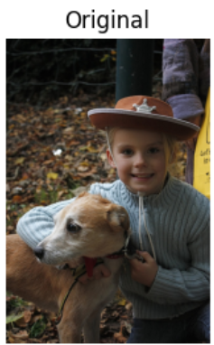
Data Preparation:
Dataset
Data Preparation
Data Preprocessing and Feature Extraction
ANN
Weighted Summarization
Post Processing
Final
Caption
COCO DATASET
FLICKR DATASET
Extracted Images
Extracting images
Downloaded FLICKR Dataset
Custom Data Set
Downloaded COCO Dataset
Unzipping the train ,test and validation data and annotation files
Extracting images
Extracted Captions
Extracting captions
Extracting captions
FIVE CAPTIONS
FIVE CAPTIONS

Slide 14
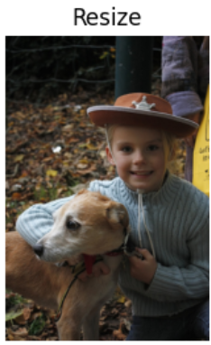
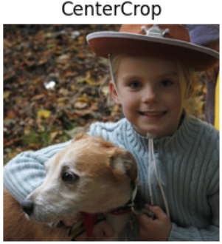

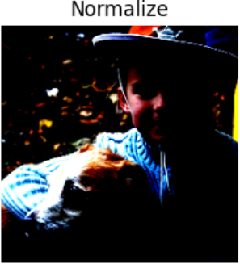
Data Preprocessing
and Feature Extraction:
This figure outlines the data preprocessing steps, including image resizing, normalization, and annotation alignment, essential for uniform model input.
Dataset
Data Preparation
Data Preprocessing and Feature Extraction
ANN
Weighted Summarization
Post Processing
Final
Caption
Resnet-50
1x1 conv,512
3x3 conv,512
1x1 conv ,2048
1x1 conv,64
3x3 conv,64
1x1 conv ,256
1x1 conv,128
3x3 conv,128
1x1 conv ,512
1x1 conv,256
3x3 conv,256
1x1 conv ,1024
Output Image features
7x7 conv, 64 strides 2
77fc,softmax
Dataset Images
Avg.
pool
Image Augmentation

Slide 15
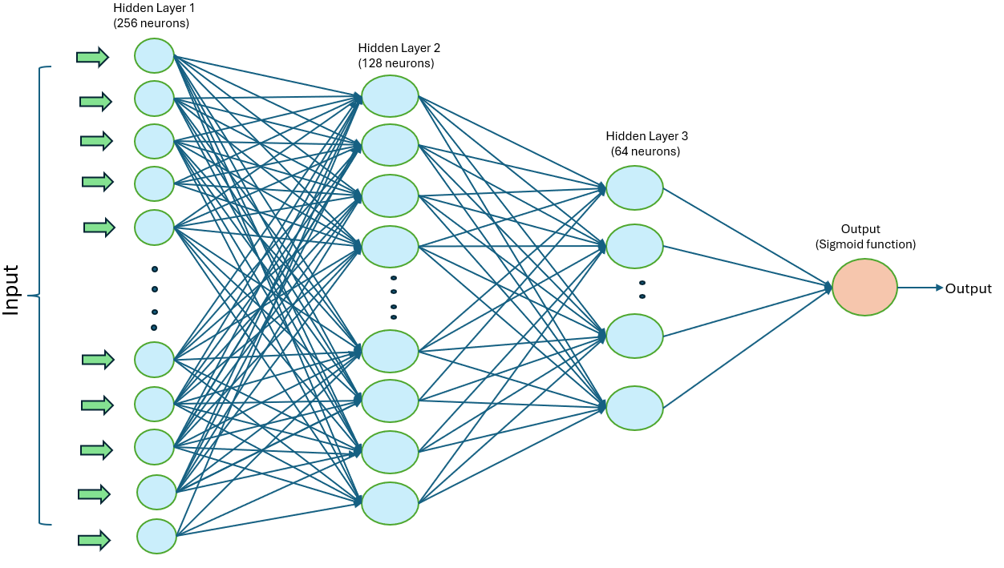
ANN:
This figure illustrates the ANN architecture used to predict weights for caption integration, enhancing the accuracy of generated image captions.
Dataset
Data Preparation
Data Preprocessing and Feature Extraction
ANN
Weighted Summarization
Post Processing
Final
Caption

Slide 16
Weighted Summarization:
This flowchart depicts the process of combining captions from BLIP and GPT-2 using dynamically assigned weights from the ANN.
Dataset
Data Preparation
Data Preprocessing and Feature Extraction
ANN
Weighted Summarization
Post Processing
Final
Caption
BLIP Generated Caption
Full Caption (from more weight transformer)+ few words from less weight transformer.
SUMMARIZER
(Distil BART)
Summarized Caption
GPT-2 Generated Captions

Slide 17
Post Processing:
This figure shows the post-processing steps, including grammar checks and sentence trimming, to refine the generated captions for improved readability and accuracy.
Dataset
Data Preparation
Data Preprocessing and Feature Extraction
ANN
Weighted Summarization
Post Processing
Final
Caption
Post Processing
Summarized Caption
Grammer and Spelling Correction
Sentence Trimming and Cleaning
Final Caption

Slide 18
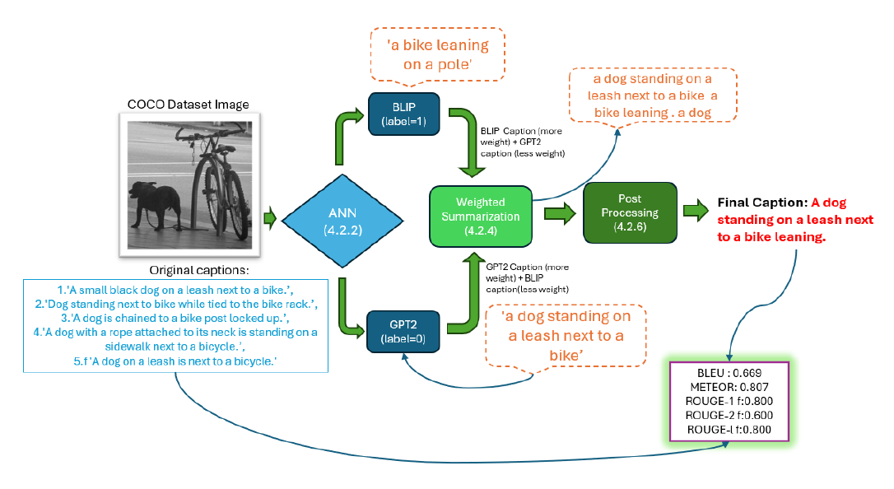
Overall Process Walkthrough with an Example :

Slide 19
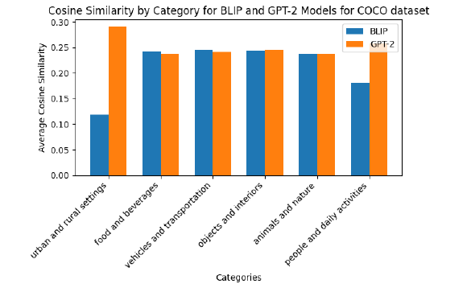
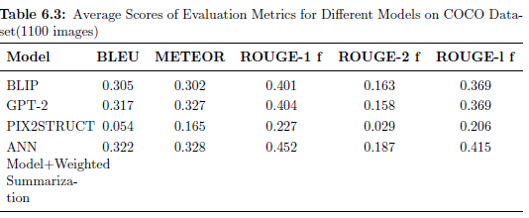
Performance along COCO Dataset and its Image Categories:
The research employed the BART classifier to categorize images and analyze the cosine similarity of captions generated by the BLIP and GPT-2 models.
In the COCO dataset, both models demonstrated competitive performance across various categories such as "food and beverages," "vehicles and transportation," "objects and interiors," and "animals and nature“. Notable differences were observed in the categories "urban and rural settings" and "people and daily activities," where GPT-2 significantly outperformed BLIP, achieving cosine similarities of 0.290 and 0.258, respectively, compared to BLIP’s 0.119 and 0.181.
This high results is also validated when more weight was given to GPT-2 in weighted summarization.
The effectiveness of GPT-2 in these categories suggests its superior ability to process complex or dynamic scenes within the COCO dataset. This finding supports a strategy of adjusting model weights based on performance to enhance caption accuracy and semantic alignment.
For COCO dataset, GPT-2 slightly outperforms BLIP in BLEU (0.317) , METEOR (0.327) and Rouge (0.404) scores

Slide 20
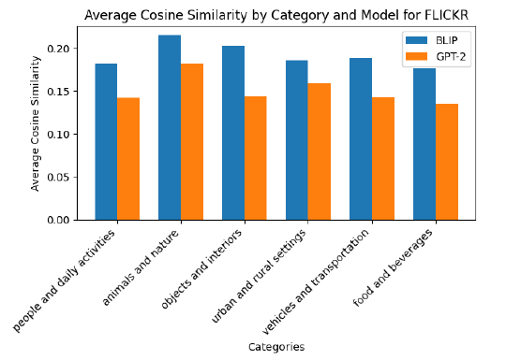
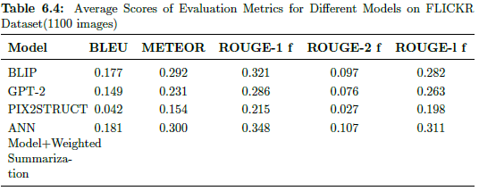
Performance along FLICKR Dataset and its Image Categories:
A similar analysis was conducted with the Flickr dataset, where BLIP consistently outperformed GPT-2 across all categories . BLIP achieved its highest cosine similarities in "animals and nature," "objects and interiors," and "people and daily activities," with scores of 0.215, 0.203, and 0.182 respectively.
These comparative results is also validated when more weight was given to BLIP in weighted summarization yielding in higher performance.
BLIP achieves a constant higher BLEU score of 0.177, METEOR 0.292, ROUGE-1 f 0.321,ROUGE-2 f 0.097 and ROUGE –l f of 0.282 as compared to the GPT-2 scores.

Slide 21
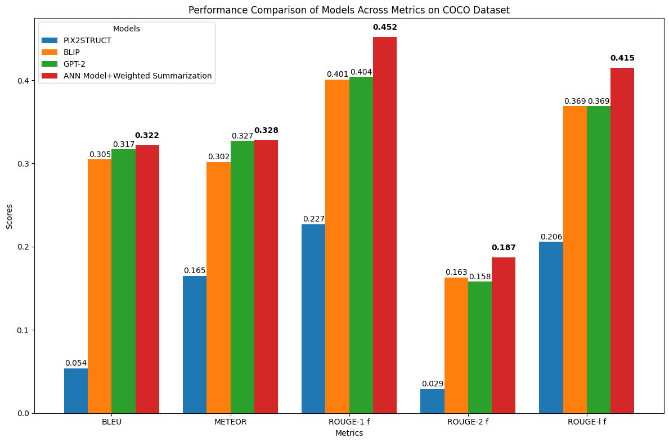
Final Results on COCO Dataset:
Performance Metrics:
Analysis:
The ANN model with weighted summarization significantly outperforms traditional models.
Key improvements include a BLEU score increase of 1.6%, METEOR score improvement by 0.3%, ROUGE-1 f score increase by 11.9%, ROUGE-2 f score increase by 14.7%, and ROUGE-l f score improvement by 12.5%.

Slide 22
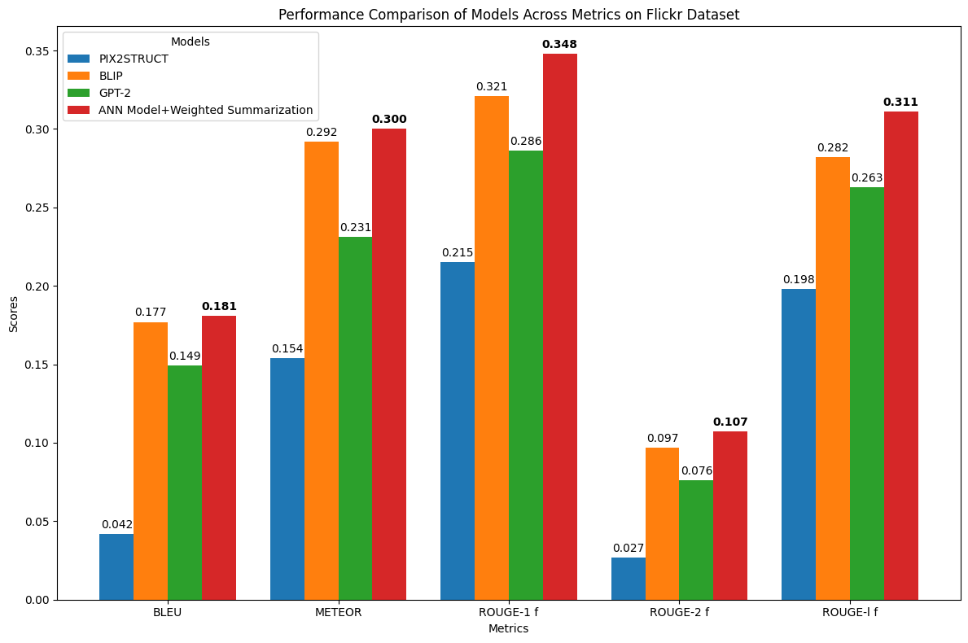
Final Results on FLICKR Dataset:
Performance Metrics:
Analysis:
The ANN model with weighted summarization outperforms established models across all metrics.
Notable improvements include a BLEU score increase by 2.3%, METEOR score enhancement by 2.7%, ROUGE-1 f score increase by 8.4%, ROUGE-2 f score improvement by 10.3%, and ROUGE-l f score increase by 10.3%.

Slide 23
Conclusion:
Overview:
This research aimed to enhance Image captioning through methodical experiments on the COCO and FLICKR datasets.
Utilized advanced machine learning models (BLIP, GPT-2, PIX2STRUCT) and innovative summarization techniques to narrow the gap between machine-generated captions and human-level annotations.
Key Achievements:
Successfully addressed research questions Q1, Q2, Q3, and Q4 through thorough experimentation, analysis, and discussion.
Validated the effectiveness of using a weighted summarization strategy based on model performance across different categories.
Integration of an ANN model with weighted summarization optimized caption generation by leveraging the strengths of the most effective model for each context.
Performance Insights:
GPT-2 performed better on COCO, while BLIP excelled on FLICKR.
Tailored weight assignments in the summarization process improved overall metrics.
Achieved high-quality image captioning without frequent retraining, demonstrating efficiency and potential to reduce computational costs.
Efficiency:
Total number of parameters: 791 million (247 million for BLIP (frozen)+239 million for GPT-2(frozen)+305 million for DistilBART(frozen)+0.3 million trainable parameters.
Minimal active training required, leading to efficient computational usage.
Total caption generation and summarization time is approximately 24.07 seconds, which is suitable for applications prioritizing
quality over speed like Data Warehouses ,Social Media Platforms ,E-commerce.
Metric Improvements:
COCO dataset: BLEU score improved to 0.322, METEOR score improved to 0.328, ROUGE-1 f , ROUGE-2 f and ROUGE-L f score improved to 0.452, 0.187 and 0.415 respectively.
FLICKR dataset: BLEU score improved to 0.181, METEOR score improved to 0.300, ROUGE-1 f , ROUGE-2 f and ROUGE-L f score improved to 0.348, 0.107 and 0.311 respectively

Slide 24
Contributions of the Research:
Evaluation Across Categories and Datasets:
Comprehensive comparison of BLIP and GPT-2 models across COCO and FLICKR datasets.
Summarization Strategies:
Explored novel summarization scenarios, enhancing the quality and relevance of generated captions.
Weighted Summarization:
Demonstrated the effectiveness of weighted summarization techniques.
Innovative Use of ANN Models:
Pioneered ANN models to predict the most effective caption generator for given images.
Foundation for Future Research:
Established a methodological framework and baseline for future research in image captioning.
Limitations:
Dataset Scope:
COCO and FLICKR datasets do not cover all possible domains, limiting generalizability.
Computational Resources:
Limited to a subset of 1100 images, which may affect the robustness and scalability of the methods.

Slide 25
Future Work:
Extending Dataset Coverage:
Test methods on a broader array of datasets to enhance versatility.
Scaling Computational Resources:
Use more powerful resources to validate findings on the full COCO and FLICKR datasets.
Advanced Model Development:
Refine and optimize ANN models and summarization techniques for better accuracy and context-awareness.
Exploring New Summarization Techniques:
Investigate additional strategies like POS tagging for improved caption quality.
Contributing to Academic Discourse:
Publish research findings to contribute valuable insights to the field.

Slide 26
This thesis marks the end of my two-year journey at NMBU, and I am deeply grateful to my supervisor, Fadi Al Machot , for his expert guidance. I also want to extend thanks to my family for their support and all the people that came in contact for this thesis.

Slide 27
Thank you for your time. ☺ We are open to Discussion and Questions.

